Slide 1
Inference in
First Order Logic
Fundamentals of Artificial Intelligence
Slides are mostly adapted from AIMA and MIT Open Courseware,
Milos Hauskrecht (U. Pittsburgh)
and Max Welling (UC Irvine)

Slide 2
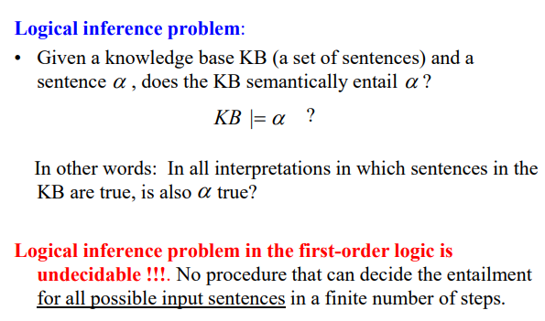
Logical Inference
Notes:
Recall that
Given a KB and a sentence alpha
KB entails alpha iff in all interpretations where KB is true, alpha is also true

Slide 3
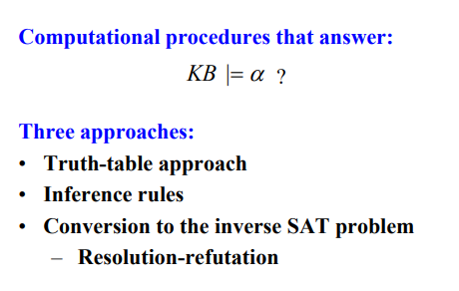
Inference in Propositional Logic
Notes:
We have seen three approaches to answer whether KB entails alpha in propositional logic
Truth table or model checking approach
Application of inference rules, such us modus ponens
And
Resultion as a proof by contradiction

Slide 4
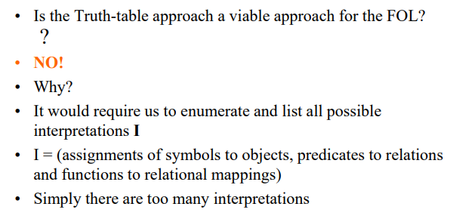
Inference in FOL : Truth Table Approach
Notes:
Model checking by truth table is not possible for FOL
Since it requires to enumarete all possible interpretations which is too many

Slide 5
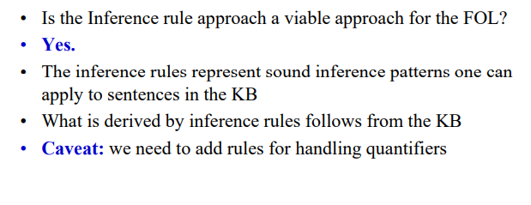
Inference in FOL: Inference Rules

Slide 6
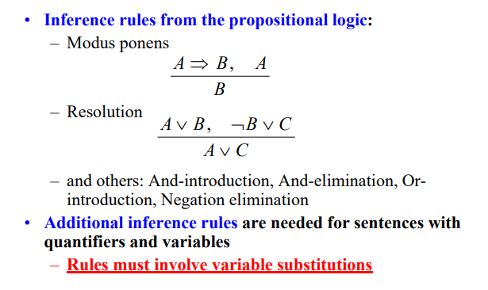
Inference Rules
Notes:
The inference rules hold for first order logic as well.
But we will need additional inference rules to handle FOL sentences with quantifiers.

Slide 7
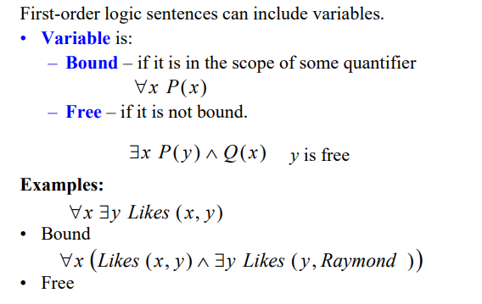
Sentences with variables
Notes:
First let’s introduce some concepts
We say that a variable in FOL is
Bound if it is in the scope of some quantifier
Or free otherwise
Let’s see some examples

Slide 8
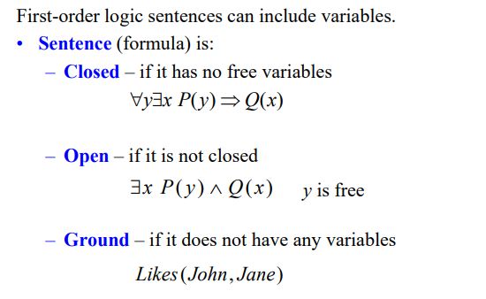
Sentences with variables
Notes:
A sentence is closed if it has no free variables
And open otherwise
The sentences having no variables at all are called ground sentences

Slide 9
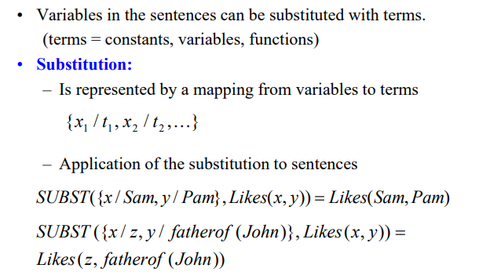
Variable Substitutions
θ =
SUBST(θ, α)
Notes:
Variables in the sentences can be substituted with terms
Remember that terms can be constants, variables or functions
A substitution is represented by a mapping from variables to terms and notated as
SUBST (theta, alpha) to denote the result of applying the substitution, or binding list, theta, to the sentence alpha
For examples substituting Sam for x, and pam for y will result in Likes(Sam,Pam)
Note that, you can substitute other variables or functions as well

Slide 10
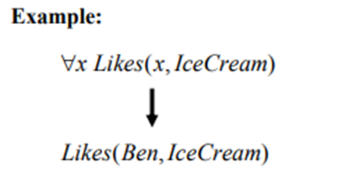

Universal elimination
Every instantiation of a universally quantified sentence is entailed by it:
∀v α
Subst({v/g}, α)
for any variable v and ground term g
E.g., ∀x King(x) ∧ Greedy(x) ⇒ Evil(x) yields:
  King(John) ∧ Greedy(John) ⇒ Evil(John), {x/John}
  King(Richard) ∧ Greedy(Richard) ⇒ Evil(Richard), {x/Richard}
  King(Father(John)) ∧ Greedy(Father(John)) ⇒ Evil(Father(John)),
  {x/Father(John)}
  .
  .
{x/Ben}
Notes:
In order to apply the inference rules, we introduce some new inference rules
Here we have to talk about substituting particular individuals for the variables
The first one is called “universal elimination”
For every sentence alpha, variable v and ground term g
We can universal elimination rule as here
It says that every instantiation of a universally quantified sentence is entailed by it
For example, if we have For all x Likes(x, Icecream) , that is everybody likes ice cream
Than we can substitute Ben for x and infer Likes(ben, IceCream)

Slide 11
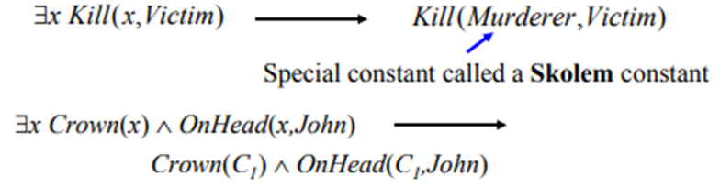

Existential elimination
For any sentence α, variable v, and constant symbol k that does not appear elsewhere in the knowledge base:
∃v α
Subst({v/k}, α)
E.g., ∃x Crown(x) ∧ OnHead(x,John) yields:
Crown(C₁) ∧ OnHead(C₁,John)
provided C₁ is a new constant symbol, called a Skolem constant
Notes:
The second rule is existential elimination
For any sentence alpha, variable v, and constant symbol k that does not appear elsewhere in KB, we can write the rule as here
This special constant is called a Skolem constant

Slide 12
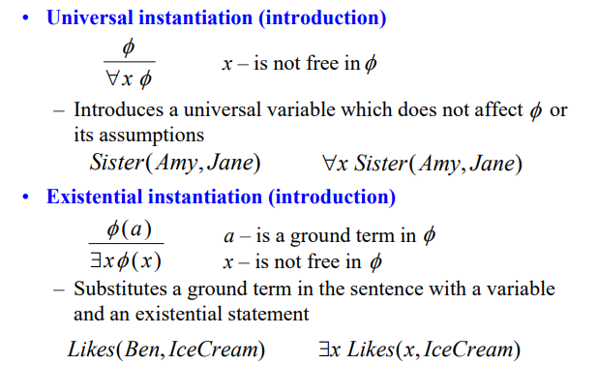
Inference rules for quantifiers
α
∃v Subst({g/v}, α)
Notes:
Universal instantiation or introduction can only introduces a universal variable which does not affect the sentence fi
Existential instantiation or introduction says that
For any sentence alpha, variable v that does not occur in alpha, and ground term g that does not occur in alpha
We can write
Alpha entails for some v alpha where g is substituted with v
For example given
Likes(Ben, IceCream)
We can write
There exists x Likes(x, IceCream)

Slide 13
Example Proof
The law says that it is a crime for an American to sell weapons to hostile nations. The country Nono, an enemy of America, has some missiles, and all of its missiles were sold to it by Colonel West, who is American.
Prove that Col. West is a criminal

Slide 14
Example knowledge base contd.
... it is a crime for an American to sell weapons to hostile nations:
  ∀x,y,z American(x) ∧ Weapon(y) ∧ Sells(x,y,z) ∧ Nation(z) ∧ Hostile(z) ⇒ Criminal(x)
Nono … has some missiles, i.e.,
  ∃x Owns(Nono,x) ∧ Missile(x):
… all of its missiles were sold to it by Colonel West
  ∀x Missile(x) ∧ Owns(Nono,x) ⇒ Sells(West,x,Nono)
Missiles are weapons:
  ∀ x Missile(x) ⇒ Weapon(x)
An enemy of America counts as "hostile“:
  ∀x Enemy(x,America) ⇒ Hostile(x)
West, who is American …
  American(West)
The country Nono
Nation(Nono)
Nono, an enemy of America …
  Enemy(Nono,America), Nation(America)

Slide 15
Example knowledge base contd.
∀ x,y,z American(x) ∧ Weapon(y) ∧ Sells(x,y,z) ∧ Nation(z) ∧ Hostile(z) ⇒ Criminal(x)
∃x Owns(Nono,x) ∧ Missile(x):
∀x Missile(x) ∧ Owns(Nono,x) ⇒ Sells(West,x,Nono)
∀ x Missile(x) ⇒ Weapon(x)
∀x Enemy(x,America) ⇒ Hostile(x)
American(West)
Nation(Nono)
Enemy(Nono,America)
Nation(America)
Owns(Nono,M₁) and Missile(M₁) Existential elimination 1,2
Owns(Nono,M₁) And elimination 10
Missile(M₁) And elimination 10
Missile(M1) ⇒ Weapon(M1) Universal elimination 4
Weapon(M1) Modus Ponens, 12, 13
Missile(M1) ∧ Owns(Nono,M1) ⇒ Sells(West,M1,Nono) Universal Elimination 3
Sells(West,M1,Nono) Modus Ponens 10,15
American(West) ∧ Weapon(M1) ∧ Sells(West,M1,Nono) ∧ Nation(Nono) ∧ Hostile(Nono) ⇒ Criminal(Nono) Universal elimination, three times 1
Enemy(Nono,America) ⇒ Hostile(Nono) Universal Elimination 5
Hostile(Nono) Modus Ponens 8, 18
American(West) ∧ Weapon(M1) ∧ Sells(West,M1,Nono) ∧ Nation(Nono) ∧ Hostile(Nono) And Introduction 6,7,14,16,19
Criminal(West) Modus Ponens 17, 20

Slide 16
Problems
The proof is very long
The branching factor increases as the knowledge base grows (some of the inference rules combine existing facts)
Universal elimination can have enormous branching factor (we can replace the variable with any ground term)
We spent a lot of time combining atomic sentences into conjunctions, instantiating universal rules to match and then applying Modus Ponens

Slide 17
Reduction to propositional inference
Suppose the KB contains just the following:
  ∀x King(x) ∧ Greedy(x) ⇒ Evil(x)
  King(John)
  Greedy(John)
  Brother(Richard,John)
Instantiating the universal sentence in all possible ways (there are only two ground terms: John and Richard) , we have:
  King(John) ∧ Greedy(John) ⇒ Evil(John)
  King(Richard) ∧ Greedy(Richard) ⇒ Evil(Richard)
  King(John)
  Greedy(John)
  Brother(Richard,John)
The new KB is propositionalized: proposition symbols are
King(John), Greedy(John), Evil(John), King(Richard), etc.

Slide 18
Reduction contd.
Every FOL KB can be propositionalized so as to preserve entailment
  A ground sentence is entailed by new KB iff entailed by original KB
Idea for doing inference in FOL:
  propositionalize KB and query
  apply inference
  return result
Problem: with function symbols, there are infinitely many ground terms,
  e.g., Father(Father(Father(John))), etc

Slide 19
Reduction contd.
Theorem: Herbrand (1930). If a sentence α is entailed by an FOL KB, it is entailed by a finite subset of the propositionalized KB
Idea: For n = 0 to ∞ do
  create a propositional KB by instantiating with depth-n terms
  see if α is entailed by this KB
Problem: works if α is entailed, loops if α is not entailed
Theorem: Turing (1936), Church (1936)
Entailment for FOL is semidecidable (algorithms exist that say yes to every entailed sentence, but no algorithm exists that also says no to every nonentailed sentence.)

Slide 20
Problems with propositionalization
Propositionalization seems to generate lots of irrelevant sentences.
E.g., from:
  ∀x King(x) ∧ Greedy(x) ⇒ Evil(x)
  King(John)
  ∀y Greedy(y)
  Brother(Richard,John)
it seems obvious that Evil(John) is entailed, but propositionalization produces lots of facts such as Greedy(Richard) that are irrelevant
With p k-ary predicates and n constants, there are p·n^{k} instantiations.
Lets see if we can do inference directly with FOL sentences

Slide 21
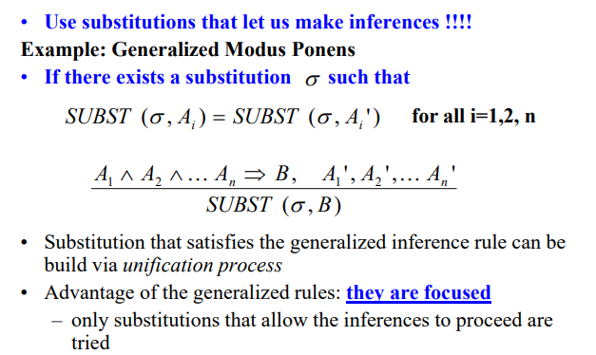
Generalized Modus Ponens

Slide 22
Generalized Modus Ponens (GMP)
where we can unify p_{i}‘ and p_{i} for all i
i.e. p_{i}'θ = p_{i} θ for all i
p₁', p₂', … , p_{n}', ( p₁ ∧ p₂ ∧ … ∧ p_{n} ⇒q)
Subst(θ,q)
Example:
p₁' is King(John) p₁ is King(x)
p₂' is Greedy(y) p₂ is Greedy(x)
θ is {x/John, y/John} q is Evil(x)
Subst(θ,q) is Evil(John)
Example:
p₁' is Missile(M1) p₁ is Missile(x)
p₂' is Owns(y, M1) p₂ is Owns(Nono,x)
θ is {x/M1, y/Nono} q is Sells(West, Nono, x)
Subst(θ,q) is Sells(West, Nono, M1)
Implicit assumption that all variables universally quantified
GMP used with KB of definite clauses (exactly one positive literal)
Notes:
Generalized Modus ponens inference rule does in a single blow what required an And-Introduction, Universal elimination, and Modus Ponens
If there is some substitutions involving x that makes the premise of the implication identical to sentences already in the knowledge base, then we can assert the conclusion of the implication, after applying substitutions
For atomic sentences pi, pi’, and q where there is a substitution theta such that
Subst(theta, pi’) = subst(theta, p’) for all I
p₁', p₂', … , p_{n}', ( p₁ ∧ p₂ ∧ … ∧ p_{n} ⇒q)
N premises pi’ are atomic sentences and there is one more premise which is the implication
The conclusion is the result of applying the substitution to the consequent q

Slide 23
Soundness and completeness of GMP
GMP is sound
  Only derives sentences that are logically entailed
Need to show that p₁', …, p_{n}', (p₁ ∧ … ∧ p_{n} ⇒ q) ╞ qθ
provided that p_{i}'θ = p_{i}θ for all I
Lemma: For any sentence p, we have p ╞ pθ by UI
  (p₁ ∧ … ∧ p_{n} ⇒ q) ╞ (p₁ ∧ … ∧ p_{n} ⇒ q)θ = (p₁θ ∧ … ∧ p_{n}θ ⇒ qθ)
  p₁', \; …, \;p_{n}' ╞ p₁' ∧ … ∧ p_{n}' ╞ p₁'θ ∧ … ∧ p_{n}'θ
  From 1 and 2, qθ follows by ordinary Modus Ponens
GMP is complete for a KB consisting of definite clauses
  Complete: derives all sentences that entailed
  OR…answers every query whose answers are entailed by such a KB
  Definite clause: disjunction of literals of which exactly 1 is positive,
  e.g., King(x) AND Greedy(x) -> Evil(x)
  NOT(King(x)) OR NOT(Greedy(x)) OR Evil(x)

Slide 24
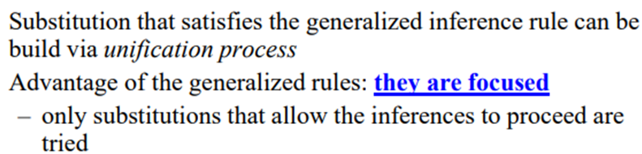

Generalized Modus Ponens (GMP)
p₁', p₂', … , p_{n}', ( p₁ ∧ p₂ ∧ … ∧ p_{n} ⇒q)
Subst(θ,q)
Convert each sentence into cannonical form prior to inference:
Either an atomic sentence or an implication with a conjunction of
atomic sentences on the left hand side and a single atom on the right
(Horn clauses)
Notes:
Generalized Modus Ponens is an efficient inference for three reasons
1. It takes bigger steps, combining several small inferences into one
It uses substitutions that are guaranteed to help rather than randomly trying Universal eliminations
A unification algorithm takes two sentences and returns a substitution that makes them look the same if such a substitution exists
3. It makes use of a precompilation step that converts all the sentences in the KB into a canonical form
Cannonical form requires Either an atomic sentence or an implication with a conjunction of
atomic sentences on the left hand side and a single atom on the right
(Horn clauses)
Now let’s see what do we mean by unification

Slide 25
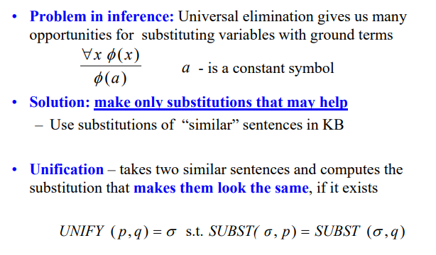
Unification
Notes:
The job of unification is to take two atomic sentences p and q and return a substitution that would make p and q look the same
If there is no such substitution it will return fail

Slide 26
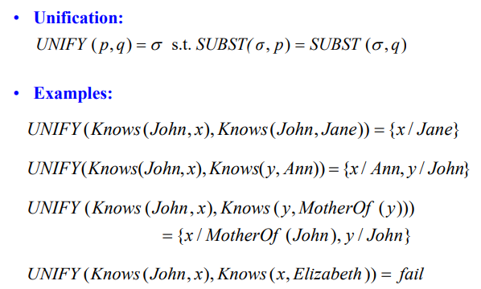
Unification

Slide 27
Unification
We can get the inference immediately if we can find a substitution θ such that King(x) and Greedy(x) match King(John) and Greedy(y)
θ = {x/John,y/John} works
Unify(α,β) = θ if αθ = βθ
p q θ
Knows(John,x) Knows(John,Jane)
Knows(John,x) Knows(y,Elizabeth)
Knows(John,x) Knows(y,Mother(y))
Knows(John,x) Knows(x, Elizabeth)
Standardizing apart eliminates overlap of variables,
e.g., Knows(z₁₇, Elizabeth)

Slide 28
Unification
We can get the inference immediately if we can find a substitution θ such that King(x) and Greedy(x) match King(John) and Greedy(y)
θ = {x/John,y/John} works
Unify(α,β) = θ if αθ = βθ
p q θ
Knows(John,x) Knows(John,Jane) {x/Jane}}
Knows(John,x) Knows(y, Elizabeth) {x/ Elizabeth,y/John}}
Knows(John,x) Knows(y,Mother(y)) {y/John,x/Mother(John)}}
Knows(John,x) Knows(x, Elizabeth) {fail}
Standardizing apart eliminates overlap of variables,
e.g., Knows(z₁₇, Elizabeth)
Notes:
Last unification fails because x cannot take on the value John and Elizabeth at the same time
One way to handle this problem is to standardize apart the two sentences being unified which means renaming the variables of one of them to avoid name clashes

Slide 29
Unification
To unify Knows(John,x) and Knows(y,z),
θ = {y/John, x/z } or θ = {y/John, x/John, z/John}
The first unifier is more general than the second.
Most general unifier is the substitution that makes the least commitment about the bindings of the variables
There is a single most general unifier (MGU) that is unique up to renaming of variables.
  MGU = { y/John, x/z }
Notes:
Most general unifier is the substitution that makes the least commitment about the bindings of the variables

Slide 30
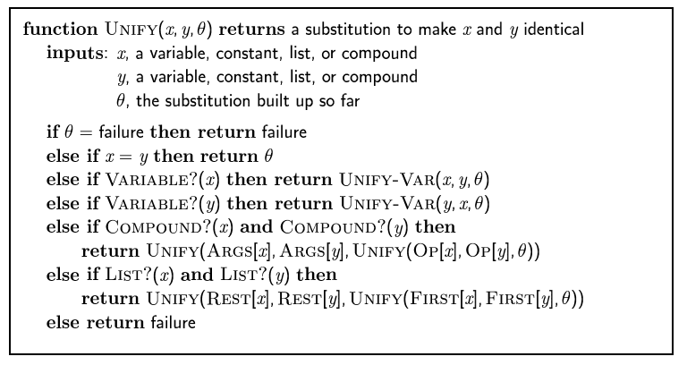
The unification algorithm

Slide 31
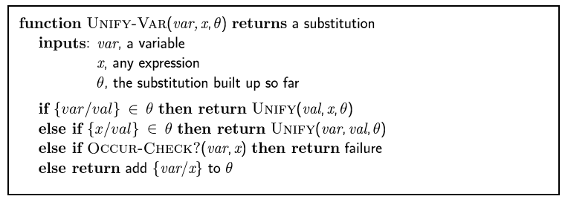
The unification algorithm

Slide 32
Example knowledge base revisited
∀ x,y,z American(x) ∧ Weapon(y) ∧ Sells(x,y,z) ∧ Nation(z) ∧ Hostile(z) ⇒ Criminal(x)
∃x Owns(Nono,x) ∧ Missile(x):
∀x Missile(x) ∧ Owns(Nono,x) ⇒ Sells(West,x,Nono)
∀ x Missile(x) ⇒ Weapon(x)
∀x Enemy(x,America) ⇒ Hostile(x)
American(West)
Nation(Nono)
Enemy(Nono,America)
Nation(America)
Convert the sentences into Horn form
American(x) ∧ Weapon(y) ∧ Sells(x,y,z) ∧ Nation(z) ∧ Hostile(z) ⇒ Criminal(x)
Owns(Nono,M₁)
Missile(M₁)
Missile(x) ∧ Owns(Nono,x) ⇒ Sells(West,x,Nono)
Missile(x) ⇒ Weapon(x)
Enemy(x,America) ⇒ Hostile(x)
American(West)
Nation(Nono)
Enemy(Nono,America)
Nation(America)
Proof
Weapon(M1)
Hostile(Nono)
Sells(West,M1,Nono)
Criminal(West)

Slide 33
Inference appoaches in FOL
Forward-chaining
  Uses GMP to add new atomic sentences
  Useful for systems that make inferences as information streams in
  Requires KB to be in form of first-order definite clauses
Backward-chaining
  Works backwards from a query to try to construct a proof
  Can suffer from repeated states and incompleteness
  Useful for query-driven inference
Note that these methods are generalizations of their propositional equivalents

Slide 34
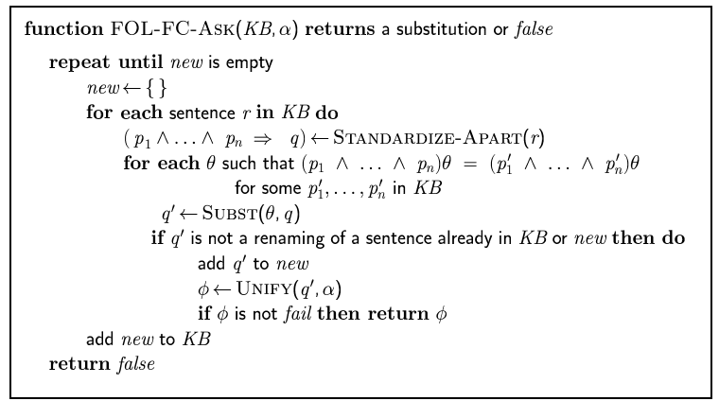
Forward chaining algorithm

Slide 35
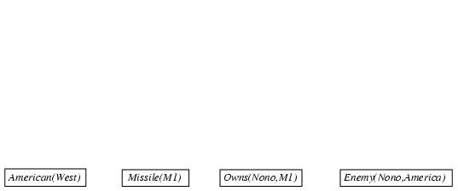
Forward chaining proof

Slide 36
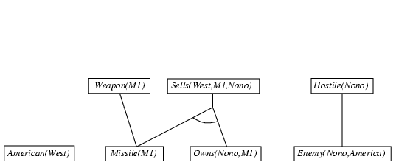
Forward chaining proof

Slide 37
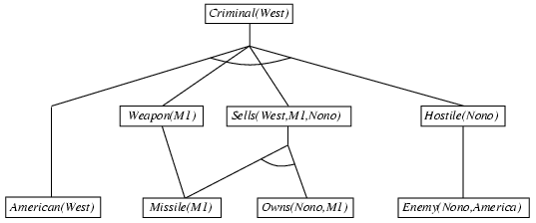
Forward chaining proof

Slide 38
Properties of forward chaining
Sound and complete for first-order definite clauses
Datalog = first-order definite clauses + no functions
FC terminates for Datalog in finite number of iterations
May not terminate in general if α is not entailed
This is unavoidable: entailment with definite clauses is semidecidable

Slide 39
Efficiency of forward chaining
Incremental forward chaining: no need to match a rule on iteration k if a premise wasn't added on iteration k-1
  ⇒ match each rule whose premise contains a newly added positive literal
Matching itself can be expensive:
Database indexing allows O(1) retrieval of known facts
  e.g., query Missile(x) retrieves Missile(M₁)
Forward chaining is widely used in deductive databases

Slide 40
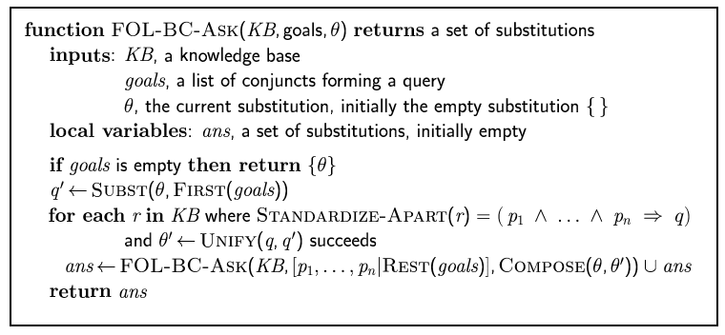
Backward chaining algorithm
SUBST(COMPOSE(θ₁, θ₂), p) =
SUBST(θ₂, SUBST(θ₁, p))

Slide 41

Backward chaining example

Slide 42
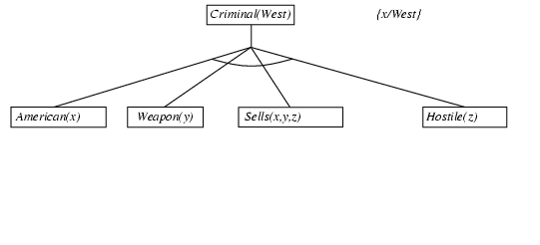
Backward chaining example

Slide 43
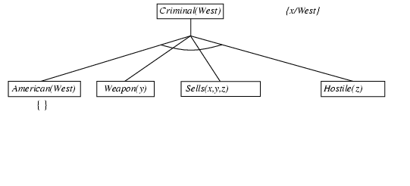
Backward chaining example

Slide 44
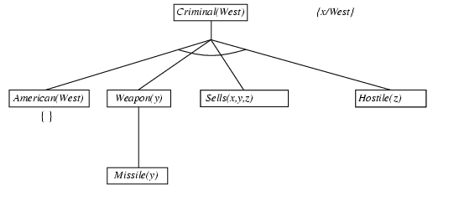
Backward chaining example

Slide 45
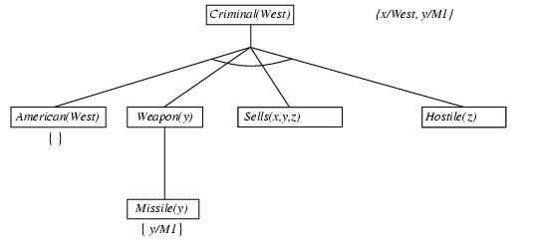
Backward chaining example

Slide 46
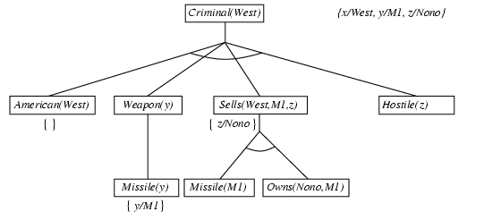
Backward chaining example

Slide 47
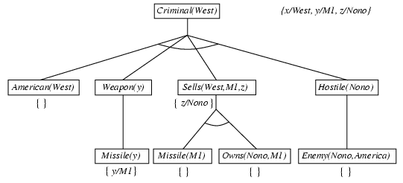
Backward chaining example

Slide 48
Backward chaining example

Slide 49
Properties of backward chaining
Depth-first recursive proof search: space is linear in size of proof
Incomplete due to infinite loops
  ⇒ fix by checking current goal against every goal on stack
Inefficient due to repeated subgoals (both success and failure)
  ⇒ fix using caching of previous results (extra space)
Widely used for logic programming

Slide 50
Logic programming: Prolog
Algorithm = Logic + Control
Basis: backward chaining with Horn clauses + bells & whistles
Program = set of clauses = head :- literal₁, … literal_{n}.
criminal(X) :- american(X), weapon(Y), sells(X,Y,Z), hostile(Z).
Depth-first, left-to-right backward chaining
Built-in predicates for arithmetic etc., e.g., X is Y*Z+3
Built-in predicates that have side effects (e.g., input and output
predicates, assert/retract predicates)
Closed-world assumption ("negation as failure")
  e.g., given alive(X) :- not dead(X).
  alive(joe) succeeds if dead(joe) fails

